Slide 1
ETL Project
Daniel Pimentel
Marie-Jeanne Beda
Ufoma iduh

Slide 2
Summary of data collected: https://www.census.gov/data/data-tools.html
Data analysis and management requires data integration. These data may come in different formats and sources such as csv files, json, files, or html tables. Integration of various datasets is a key for data analysis. In other words, identifying the dataset, extracting and reading the data, cleaning and structuring it in the desired format, and loading the clean data into a database for storage is imperative for analysis and management. Integrating this is an important part of working with data. For this ETL project we will use The United States Census Bureau website, which contains U.S. annual retail trade data in terms of total sales, sales taxes, inventories and purchases.

Slide 3
Data Format
The United States Census Bureau website annual retail trade data are listed in a CSV files. The site uses North American Industry Classification System or NAICS codes. We will use these codes. There is a total of 4 CSV files which were extracted using the NAICS codes. These datasets are Total Sales, Inventory, Purchases, and Gross Margin csv files.

Slide 4
Data Extraction and Cleanup/Transformation
In the clean-up process, we used pandas to extract the csv files. Cleaning the data required us to strip away any unnecessary variables/information. The datasets will require us to use the y-axis labels as our columns and we will transpose the dataset using Jupyter Notebook. Finally, we pushed the dataset into PostgreSQL database and joined the four tables using year as the primary key.
On the PostgreSQL side, we created a Database called UCB_DB, and created tables which enabled the engine connection to be established.
We encountered a challenge of having a single line of data during the transposition because the CSV files that we extracted were all aggregated data for the given period of years.

Slide 5
Data Storage into a Database
We used relational database-PostgreSQL database, for storage and created a connection using Jupyter Notebook. We then created a database, pushed and joined the tables using Year as the primary key for joining the CSV files.

Slide 6
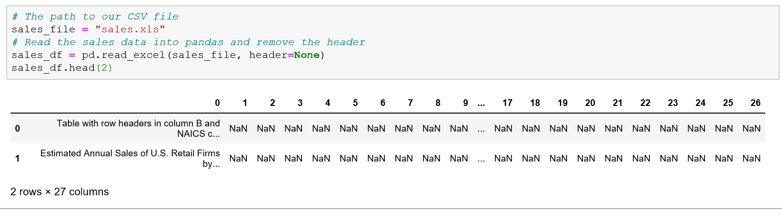
Extraction

Slide 7
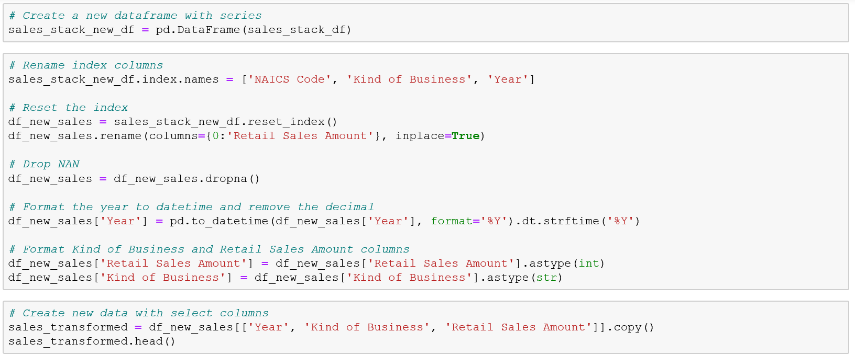
Transformation- Screenshot 1: Data cleaning

Slide 8
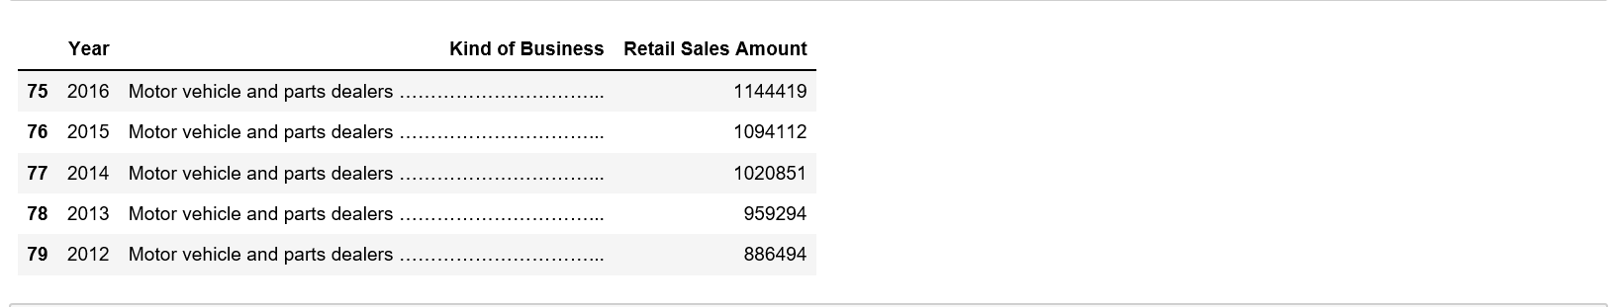
Transformation- Screenshot 1: Data cleaning

Slide 9
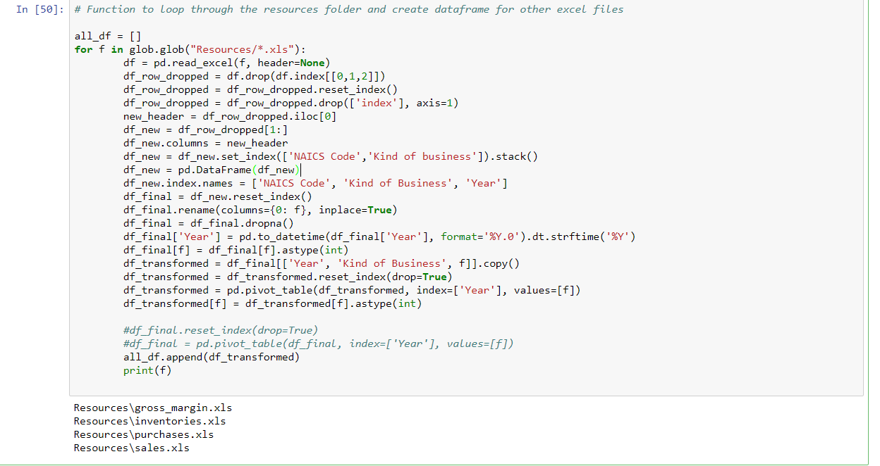
Transformation- Screenshot 2: Cleaning all CSV files using the globe module

Slide 10
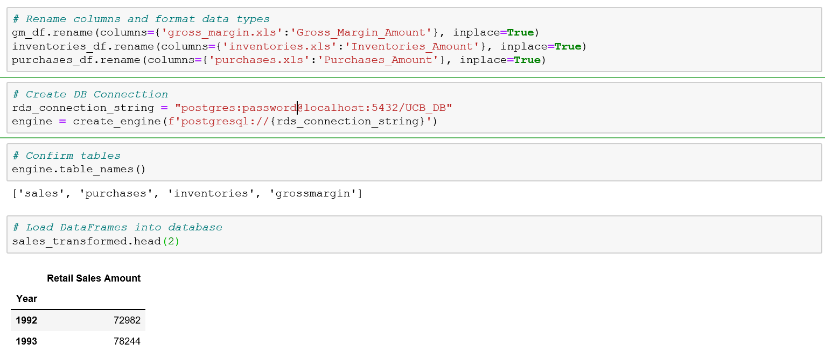
Loading to PostgreSQL - Screenshot 1: Database Connection and Data Frame Loading

Slide 11
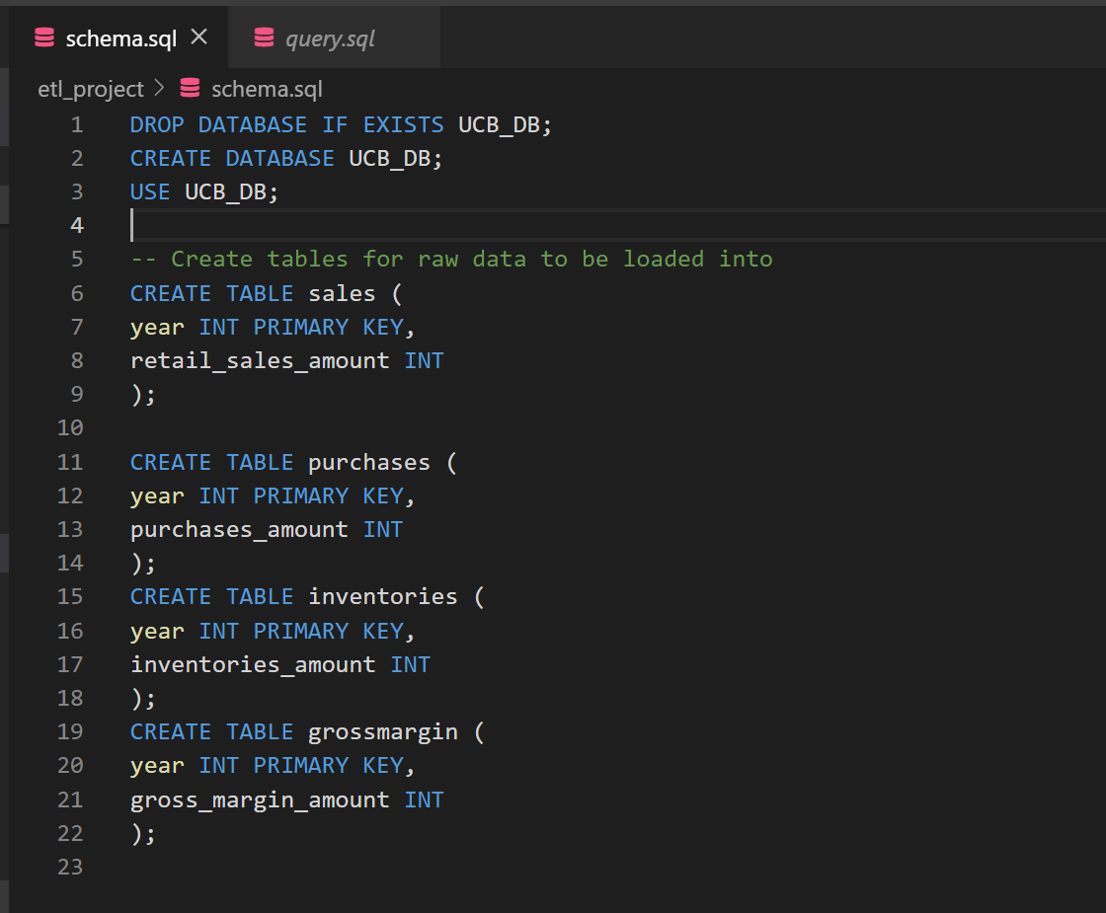
Loading to PostgreSQL – Screenshot 2: Database and Table Creation

Slide 12
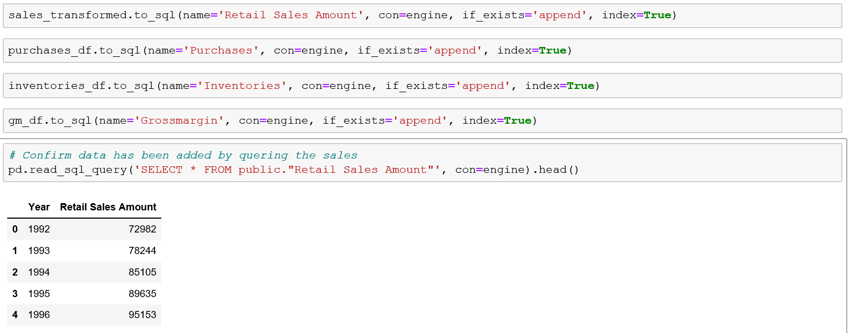
Loading to PostgreSQL from jupyter notebook- Screenshot 3: Query

Slide 13
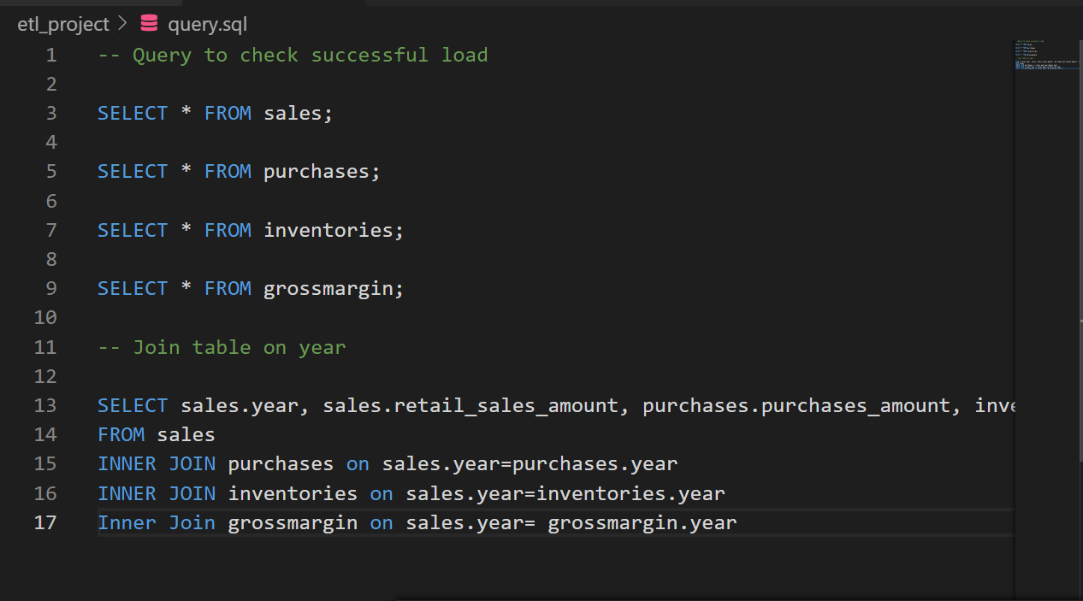
Loading to PostgreSQL - Screenshot 4: Query joining the Table

Slide 14
References
https://www.census.gov/data/data-tools.html
https://www.postgresql.org

